Slide 1





Loops
Repeating Code Multiple Times
SoftUni Team
Technical Trainers
Software University
http://softuni.bg

Slide 2



Table of Contents
What is a Loop?
Loops in C#
while loops
do … while loops
for loops
foreach loops
Special loop operators
break, continue, goto
Nested loops

Slide 3
Loop: Definition
A loop is a control statement that repeats the execution of a block of statements
May execute a code block fixed number of times
May execute a code block while given condition holds
May execute a code block for each member of a collection
Loops that never end are called an infinite loops
while (condition)
{
statements;
}

Slide 4

Using while(…) Loop
Repeating a Statement While Certain Condition Holds

Slide 5
How To Use While Loop?
The simplest and most frequently used loop
The repeat condition
Returns a boolean result of true or false
Also called loop condition
while (condition)
{
statements;
}

Slide 6
While Loop: How It Works?
condition
false
true
statement

Slide 7
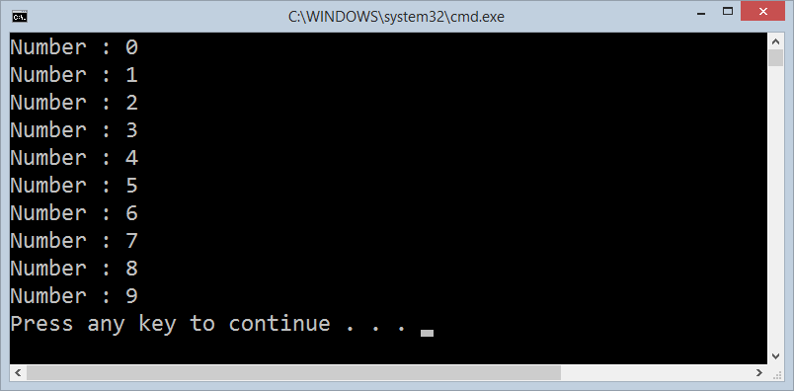
While Loop – Example
int counter = 0;
while (counter < 10)
{
Console.WriteLine("Number : {0}", counter);
counter++;
}

Slide 8

while(…) Loop
Examples

Slide 9
Sum 1..N – Example
Calculate and print the sum of the first N natural numbers
Console.Write("n = ");
int n = int.Parse(Console.ReadLine());
int number = 1;
int sum = 1;
Console.Write("The sum 1");
while (number < n)
{
number++;
sum += number ;
Console.Write("+{0}", number);
}
Console.WriteLine(" = {0}", sum);

Slide 10

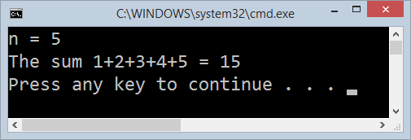
Calculating Sum 1..N
Live Demo

Slide 11
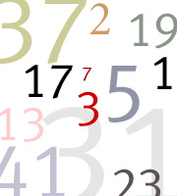
Prime Number Check – Example
Console.Write("Enter a positive integer number: ");
uint number = uint.Parse(Console.ReadLine());
uint divider = 2;
uint maxDivider = (uint) Math.Sqrt(number);
bool prime = true;
while (prime && (divider <= maxDivider))
{
if (number % divider == 0)
{
prime = false;
}
divider++;
}
Console.WriteLine("Prime? {0}", prime);

Slide 12
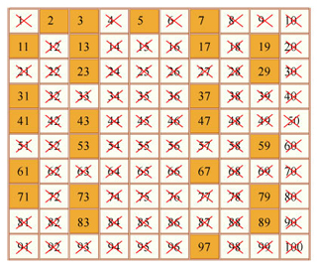
Checking Whether a Number Is Prime
Live Demo

Slide 13
Using the break Operator
The break operator exits the inner-most loop
static void Main()
{
int n = Convert.ToInt32(Console.ReadLine());
// Calculate n! = 1 * 2 * ... * n
int result = 1;
while (true)
{
if (n == 1)
break;
result *= n;
n--;
}
Console.WriteLine("n! = " + result);
}

Slide 14
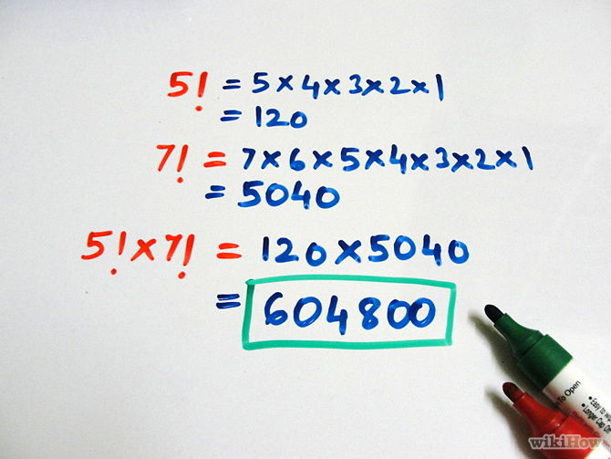
Calculating Factorial
Live Demo

Slide 15

do { … } while (…) Loop

Slide 16

Using Do-While Loop
Another classical loop structure is:
The block of statements is repeated
While the boolean loop condition holds
The loop is executed at least once
do
{
statements;
}
while (condition);

Slide 17
Do-While Statement: How It Works?
statements
true
condition
false

Slide 18

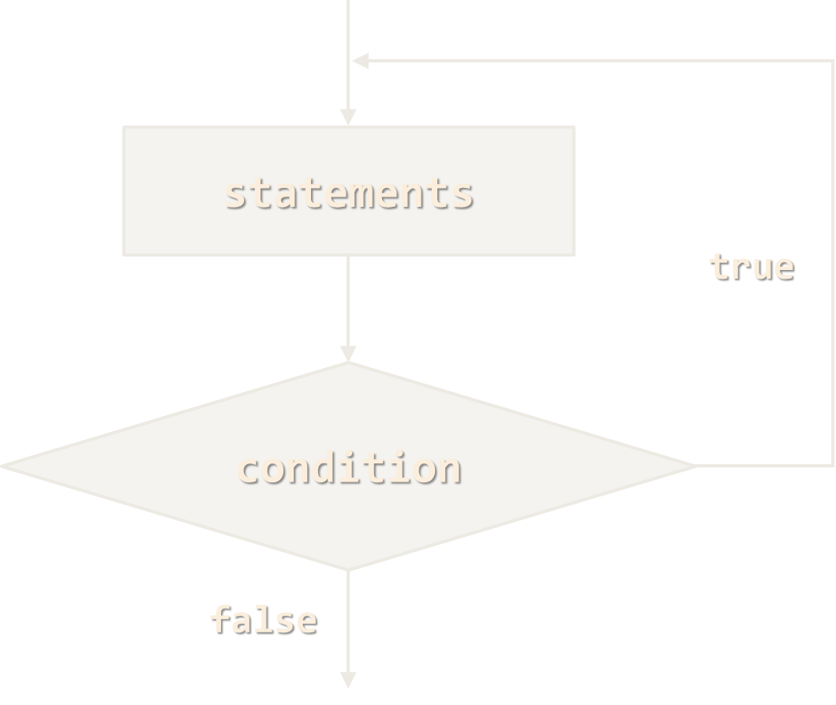
do { … } while (…)
Examples

Slide 19
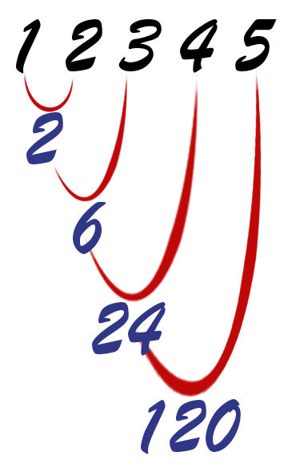
Calculating N Factorial – Example
static void Main()
{
string numberAsString = Console.ReadLine();
int n = Convert.ToInt32(numberAsString);
int factorial = 1;
do
{
factorial *= n;
n--;
}
while (n > 0);
Console.WriteLine("n! = " + factorial);
}

Slide 20
Factorial with BigInteger – Example
using System.Numerics;
static void Main()
{
int n = 1000;
BigInteger factorial = 1;
do
{
factorial *= n;
n--;
}
while (n > 0);
Console.WriteLine("n! = " + factorial);
}
Don't forget to add a reference to System.Numerics.dll.

Slide 21
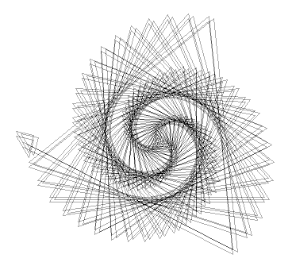
Factorial (do ... while)
Live Demo

Slide 22
Product of Integers [N..M] – Example
Calculating the product of all integers in the interval [n..m]:
int n = int.Parse(Console.ReadLine());
int m = int.Parse(Console.ReadLine());
int number = n;
decimal product = 1;
do
{
product *= number;
number++;
}
while (number <= m);
Console.WriteLine("product[{0}..{1}] = {2}", n, m, product);

Slide 23
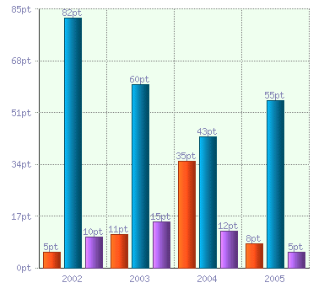
Product of the Integers in the Interval [n..m]
Live Demo

Slide 24

for Loops

Slide 25
For Loops
The typical for loop syntax is:
Consists of
Initialization statement
Boolean test expression
Update statement
Loop body block
for (initialization; test; update) { statements; }

Slide 26
The Initialization Expression
for (int number = 0; ...; ...) { // Can use number here } // Cannot use number here (out of scope)
The initialization expression
Executed once, just before the loop is entered
Like it is out of the loop, just before it
Typically used to declare a counter variable

Slide 27
The Test Expression
for (int number = 0; number < 10; ...) { // Can use number here } // Cannot use number here (out of scope)
The test expression is evaluated before each loop iteration
If true, the loop body is executed
If false, the loop finishes (and the loop body is skipped)
Used as a loop condition

Slide 28
The Update Expression
for (int number = 0; number < 10; number++) { // Can use number here } // Cannot use number here (out of scope)
The update expression
Executed at each iteration after the body of the loop is finished
Typically used to update the loop counter
Can update multiple variables

Slide 29

for Loop
Examples

Slide 30
Simple for Loop – Example
A simple for-loop to print the numbers 0…9:
for (int number = 0; number < 10; number++)
{
Console.Write(number + " ");
}
A simple for-loop to calculate n!:
decimal factorial = 1;
for (int i = 1; i <= n; i++)
{
factorial *= i;
}

Slide 31
Complex for Loop – Example
A complex for-loop could have several counter variables:
for (int i = 1, sum = 1; i <= 128; i = i * 2, sum += i)
{
Console.WriteLine("i={0}, sum={1}", i, sum);
}
Result:
i=1, sum=1
i=2, sum=3
i=4, sum=7
i=8, sum=15
...

Slide 32

For Loops
Live Demo

Slide 33
N^M – Example
Calculating n to power m (denoted as n^m):
static void Main()
{
int n = int.Parse(Console.ReadLine());
int m = int.Parse(Console.ReadLine());
decimal result = 1;
for (int i=0; i<m; i++)
{
result *= n;
}
Console.WriteLine("n^m = " + result);
}

Slide 34

Calculating N^M
Live Demo

Slide 35
Using the continue Operator
continue bypasses the iteration of the inner-most loop
Example: sum all odd numbers in [1…n], not divisors of 7:
int n = int.Parse(Console.ReadLine());
int sum = 0;
for (int i = 1; i <= n; i += 2)
{
if (i % 7 == 0)
{
continue;
}
sum += i;
}
Console.WriteLine("sum = {0}", sum);

Slide 36

Using the continue Operator
Live Demo

Slide 37

foreach Loop
Iterating over a Collection

Slide 38
For-Each Loops
The typical foreach loop syntax is:
Iterates over all the elements of a collection
The element is the loop variable that takes sequentially all collection values
The collection can be list, array or other group of elements of the same type
foreach (var element in collection) { statements; }

Slide 39
foreach Loop – Example
Example of foreach loop:
The loop iterates over the array of day names
The variable day takes all its values
Inside a foreach loop we cannot modify the current item
string[] days = {
"Monday", "Tuesday", "Wednesday", "Thursday",
"Friday", "Saturday", "Sunday" };
foreach (var day in days)
{
Console.WriteLine(day);
}

Slide 40

foreach Loop
Live Demo

Slide 41

Nested Loops
Using a Loop Inside a Loop

Slide 42
What Is Nested Loop?
A composition of loops is called a nested loop
A loop inside another loop
for (initialization; test; update)
{
for (initialization; test; update)
{
statements;
}
…
}

Slide 43

Nested Loops
Examples

Slide 44
Triangle – Example
Print the following triangle of numbers:
int n = int.Parse(Console.ReadLine());
for (int row = 1; row <= n; row++)
{
for (int column = 1; column <= row; column++)
{
Console.Write("{0} ", column);
}
Console.WriteLine();
}
1
1 2
…
1 2 3 … n

Slide 45

Triangle of Numbers
Live Demo

Slide 46
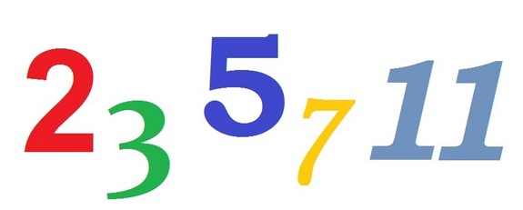
Primes in the Range [N … M] – Example
int n = int.Parse(Console.ReadLine());
int m = int.Parse(Console.ReadLine());
for (int number = n; number <= m; number++)
{
bool prime = true;
int divider = 2;
int maxDivider = Math.Sqrt(number);
while (divider <= maxDivider)
{
if (number % divider == 0)
{
prime = false;
break;
}
divider++;
}
if (prime)
Console.Write("{0} ", number);
}

Slide 47

Primes in the Range [n, m]
Live Demo

Slide 48
C# Jump Statements
Jump statements are:
break, continue, goto
How continue woks?
In while and do-while loops jumps to the test expression
In for loops jumps to the update expression
To exit the most-inner loop use break
To exit from an outer loop use goto with a label
Note: avoid using goto! (it is considered harmful)

Slide 49
C# Jump Statements – Example
int outerCounter = 0;
for (int outer = 0; outer < 10; outer++)
{ for (int inner = 0; inner < 10; inner++)
{ if (inner % 3 == 0)
continue; if (outer == 7)
break; if (inner + outer > 9)
goto breakOut; }
outerCounter++;
} breakOut:
Label

Slide 50

Loops: More Examples

Slide 51
Nested Loops – Examples
Print all four digit numbers in format ABCD such that A+B = C+D (known as happy numbers)
Can you improve this algorithm to use only 3 nested loops?
static void Main()
{
for (int a = 1; a <= 9; a++)
for (int b = 0; b <= 9; b++)
for (int c = 0; c <= 9; c++)
for (int d = 0; d <= 9; d++)
if (a + b == c + d)
Console.WriteLine("{0}{1}{2}{3}", a, b, c, d);
}

Slide 52

Happy Numbers
Live Demo

Slide 53
Nested Loops – Examples
Print all combinations from TOTO 6/49 lottery
static void Main()
{
int i1, i2, i3, i4, i5, i6;
for (i1 = 1; i1 <= 44; i1++)
for (i2 = i1 + 1; i2 <= 45; i2++)
for (i3 = i2 + 1; i3 <= 46; i3++)
for (i4 = i3 + 1; i4 <= 47; i4++)
for (i5 = i4 + 1; i5 <= 48; i5++)
for (i6 = i5 + 1; i6 <= 49; i6++)
Console.WriteLine("{0} {1} {2} {3} {4} {5}",
i1, i2, i3, i4, i5, i6);
}
Warning: the execution of this code could take a very long time.

Slide 54

TOTO 6/49
Live Demo

Slide 55

Summary
C# supports four types of loops:
while loops
do-while loops
for loops
foreach loops
Nested loops are used to implement more complex logic
The operators continue, break & goto can change the default loop execution behavior

Slide 56









Loops: Repeating Code Multiple Times
https://softuni.bg/courses/programming-basics/

Slide 57
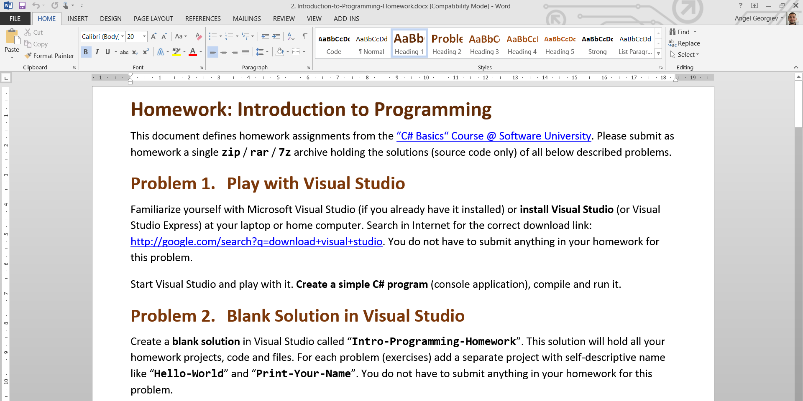
Homework Review
Live Demo

Slide 58
License
This course (slides, examples, demos, videos, homework, etc.) is licensed under the "Creative Commons Attribution-NonCommercial-ShareAlike 4.0 International" license
Attribution: this work may contain portions from
"Fundamentals of Computer Programming with C#" book by Svetlin Nakov & Co. under CC-BY-SA license
"C# Part I" course by Telerik Academy under CC-BY-NC-SA license

Slide 59





Free Trainings @ Software University
Software University Foundation – softuni.org
Software University – High-Quality Education, Profession and Job for Software Developers
softuni.bg
Software University @ Facebook
facebook.com/SoftwareUniversity
Software University @ YouTube
youtube.com/SoftwareUniversity
Software University Forums – forum.softuni.bg

